Slide 1
The climate emergency is a health emergency. Joining the dots towards a Net Zero NHS
Dr Helena Clements
Consultant Paediatrician
Clinical Director for Notts Net Zero Integrated Care System

Slide 2
Carbon costs…?
A punnet of strawberries (in-season, in-country)
Inpatient bed day (high intensity ward)
A burger
A new car (Land Rover Discovery)
Heart bypass operation
Acute sector outpatient appointment
A banana
Return flight from London to Hong Kong
Congested commute by car (5 miles return)
An email
A&E visit
GP appointment (excluding pharmaceuticals)

Slide 3
J | An email | 4g CO2e
G | A banana | 80g CO2e
A | A punnet of strawberries (in-season, in-country) | 150g CO2e (own country)/ 1.8kg CO2e (out of season)
C | A burger | 2.5kg CO2e (4oz cheeseburger)
L | GP appointment (excluding pharmaceuticals) | 6kg CO2e
K | A&E visit | 13.8kg CO2e
I | Congested commute by car (5 miles return) | 22kg CO2e (average car)
F | Acute sector outpatient appointment | 23kg CO2e
B | Inpatient bed day (high intensity ward) | 89.5kg CO2e
E | Heart bypass operation | 1.1 tonnes CO2e
H | Return flight from London to Hong Kong | 3.4 tonnes CO2e (economy)
D | A new car (Land Rover discovery) | 35 tonnes CO2e

Slide 4
My life for 20 years
DrClements+MrsTilley

Slide 5
About 5 years ago
Grandson born
What’s the point of being a Paediatrician?
Need to do more for him and all children
Extinction rebellion/ Activism
Board time out
Conversation with the Chair
RCPCH/ FMLM -Why aren’t we talking about climate change?

Slide 6
Climate action
We all need to engage with this
Working towards Zero carbon NHS
Trust green plan/ ICS green plan
60% of CO2 emissions related to clinical activity including drugs, gases, clinical consumables and procurement etc.
Solutions need to be clinically led.

Slide 7
Opportunities
Increasing interest in zero carbon NHS
Increasing evidence of climate change
Funding opportunities ( always tight time scales)
ICB- new age of collaboration

Slide 8
Challenges
Budgetary constraints – short termism
Little room for long term planning and looking at long term HEALTH solutions
Current pressures dictate more of the same
Model of growth… more , more MORE!

Slide 9
Joining the dots

Slide 10
Climate action
Personal
Corporate
Political

Slide 11
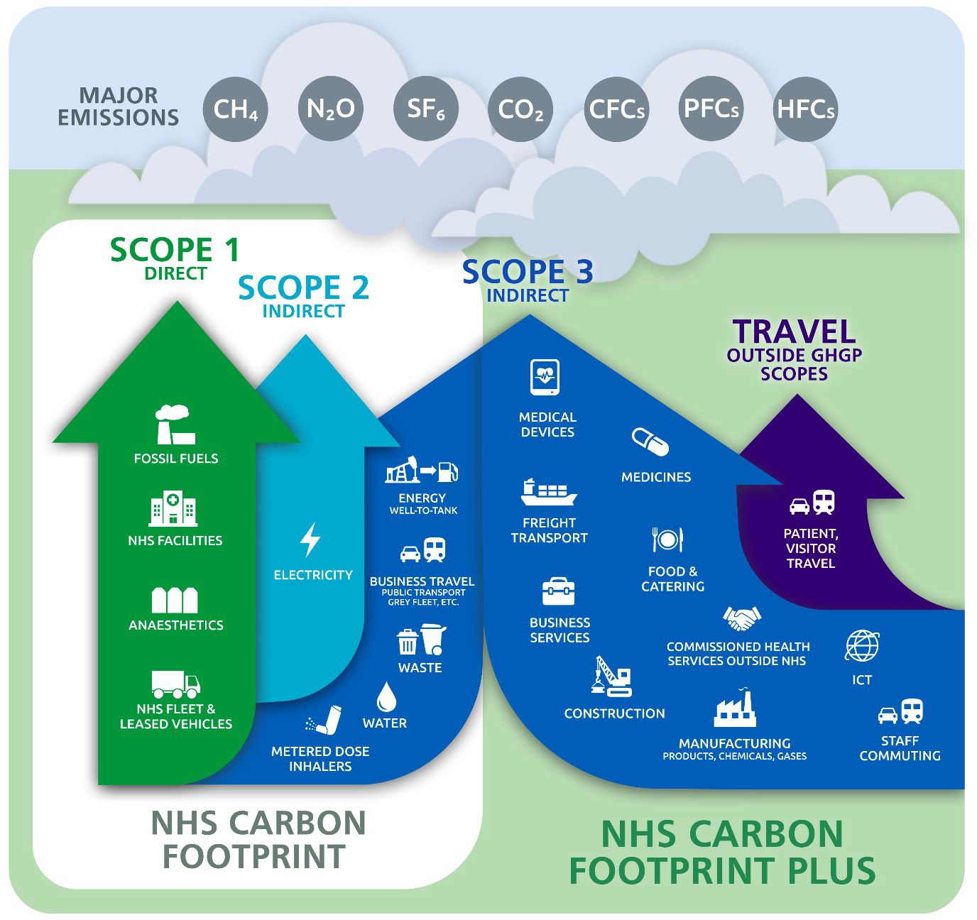
NHS Carbon emissions

Slide 12
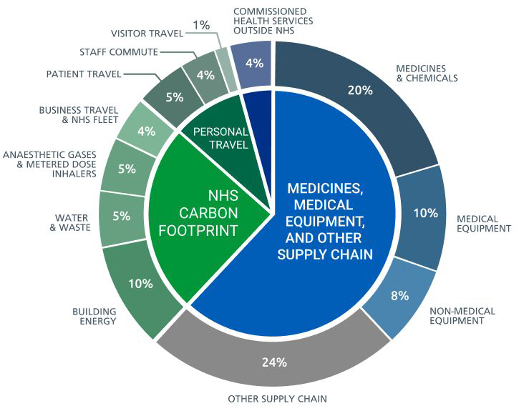
NHS Carbon Plus -

Slide 13
See the big picture for our patitents
Ill health
Diet
Exercise
Mental Health
Housing
Employment
Education
Travel

Slide 14
See the bigger picture for climate
Housing
Energy
Water
Health vs. Ill health
Environment
Biodiversity
WAR
Migration
Food

Slide 15
Nottinghamshire ICB Green Plan
All ICS across UK had to produce a green plan by 31/03/22
Individual trust green plans signed off Jan 2022 at latest
Chapter headings specified by NHSE
Working towards Zero CO2 NHS by 2032 (80%) and 100% by 2040

Slide 16
Stakeholders
NUH
SFH
NHT
City Care
Notts County Council (includes public health)
Notts City Council (includes public health)

Slide 17
Chapter headings
Workforce system and leadership
Sustainable models of care
Digital transformation
Travel and transport
Estates and facilities
Medicines
Supply chain and procurement
Food and nutrition
Adaptation

Slide 18
Clinical leadership
Sustainable models of care
Digital transformation
Medicines
Supply chain and procurement
Food and nutrition

Slide 19
Examples of quick wins
Very low use of Desflurane across Notts
ICS wide work on transition to low carbon inhalers and safer inhaler disposal
Trial of NO scavenging (SFH)
Review of single use items in anaesthetic trays for regional anaesthesia
Walking aid reuse scheme
Ophthalmology service redesign
Digital appointment letters

Slide 20
What about the long view
Focus on health promotion
Healthy diet and exercise
Emotional health and wellbeing
Sustainable homes
Education to promote sustainable living
Public transport and active travel
Clean air
Build resilience

Slide 21
Health outcomes of uncontrolled climate change
More Obesity
Type 2 Diabetes and complications
More cardiovascular , respiratory disease and strokes due to poor air quality
Mental health impacts of ill health, environmental degradation,
Health impacts of climate events including extreme heat, flooding, food insecurity, infectious diseases
Impacts of global climate change including war, migration, food insecurity and economic collapse

Slide 22
Health benefits of a zero carbon future
Health rather than ill health
Reduced demand and costs to NHS, reduced cost to individuals, more productive,
Low carbon diet / locally sourced food/ regenerative farming / reduced food waste/
Reduced obesity , T2DM and related complications
Increased activity / access to green spaces/ sustainable travel
Improved physical and mental health
Improved air quality and health benefits
Social integration

Slide 23
Pro-active work programme -suggestions
60% CO2 emission are due to direct clinical care – clinical solutions are needed
How do we increase impact of public health initiatives to reduce demand?
Lean pathways -
Medicines – life cycle analysis, reduce unnecessary waste, non pharmacological solutions
Single use items
Procurement – inc packaging, compostable plastics in disposables, system wide sourcing of lower carbon products to reduce costs
Out reach / education / communication – Climate crisis = Health crisis
Amplification of ideas and success.

Slide 24
ICS Net Zero Faculty
Created by need for clinical resource
4 HEE/NHSE funded fellows – 2 days per week for 12/12
PH registrar
Dietician
Physio
Anaesthetist
Other resources
Medical students SSM/ Dissertation
Pre-reg pharmacist projects
GP –phoenix scheme / HEE Management fellows
Management trainees

Slide 25
Purpose of faculty
Develop clinical climate leaders for the future
Explore ideas, test, refine and AMPLIFY
Teach- climate literacy
Inspire and coach
Communications

Slide 26
Climate action
Personal
Corporate
Political

Slide 27
Joining the Dots with SHOCK
We are daughters, sons, parents, grandparents, siblings, colleagues, neighbours, friends
We are all shareholders
Investors in SHOCK = Investors in low carbon future
We all have agency – choices, influence, power
We should use them

Slide 28
What will you do tomorrow?

Slide 29
Thanks
Any thoughts or comments?

