Slide 1

SHOCK AGM · 2026
Energy Local
Southwell
FULL
PARTIAL
What customers experience as local generation changes
NONE
One reliable supply.
A changing local match.

Slide 2
ENERGY LOCAL · THE MODEL
Energy Local gives local generation more value by matching it with local demand
01
A local cooperative
02
Half-hourly matching
03
A shared better deal
Households and small renewable generators join an Energy Local Club.
Smart-meter data shows when members use electricity as local power is generated.
Matched electricity uses the Club’s agreed Match Tariff; unmatched demand comes from the supplier.
FOR LOCAL GENERATORS
FOR LOCAL CLUB MEMBERS
A fairer route to market
Lower bills. More local value.
The Club agrees a Match Tariff that can pay more than conventional export arrangements.
Matched local electricity is cheaper than the standard supply rate agreed for the Club.
Better income can help existing schemes remain viable and support more local renewables.
Members can save more by shifting some use to times when local generation is available.
Sources: energylocal.org.uk/about-us · /settle/key-info · /generalFAQs · /demandshiftingblog
SOUTHWELL ENERGY LOCAL CLUB · SHOCK AGM
02

Slide 3
THE OFFER
Local matching unlocks a 40% lower electricity rate
STANDARD 100GREEN
SHOCK-MATCHED
40%
100
→
60
discount on the standard
100Green electricity tariff
indexed rate
indexed rate
The customer benefit follows the share of demand that SHOCK generation can match.
SOUTHWELL ENERGY LOCAL CLUB · SHOCK AGM
03

Slide 4
TARIFF DETAIL · PRICES PER kWh · FIXED TO 31 MARCH 2027
Matched tariffs are 40% lower in every time band
MON–FRI
TIME BAND | 100GREEN TOUT STANDARD TARIFF | LOCAL ENERGY MATCH TARIFF
00:00–07:00 · Cheap | 14.93p | 8.96p
16:00–20:00 · Peak | 27.08p | 16.25p
All other times · Standard | 22.88p | 13.73p
WEEKENDS
TIME BAND | 100GREEN TOUT STANDARD TARIFF | LOCAL ENERGY MATCH TARIFF
00:00–07:00 · Cheap | 14.93p | 8.96p
07:00–00:00 · Standard | 22.88p | 13.73p
SOUTHWELL ENERGY LOCAL CLUB · SHOCK AGM
04

Slide 5
GENERATION INCOME · FROM 1 OCTOBER
100Green raises SHOCK’s PPA rate to 9.26p/kWh
GOOD ENERGY · PREVIOUS
100GREEN · FROM 1 OCTOBER
+2.08p
7.18p
→
9.26p
more for every
unmatched kWh
per kWh
unmatched rate per kWh
If local club members use SHOCK generation, that matched amount receives the time-banded Match tariff instead.
Note: from midnight–07:00, matched consumption earns 0.3p/kWh less than the 9.26p PPA rate, but still 1.78p/kWh more than the former Good Energy rate. At all other times, matched consumption earns more.
SOUTHWELL ENERGY LOCAL CLUB · SHOCK AGM
05

Slide 6
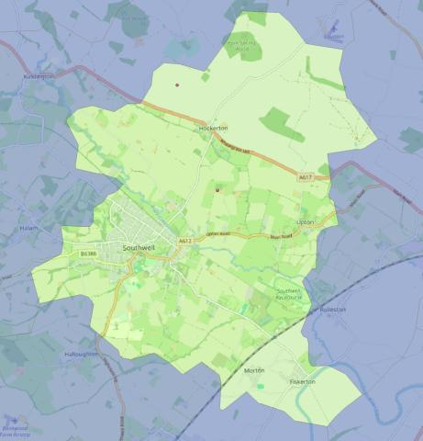

WHO CAN BENEFIT
The local Match tariff is available within the SHOCK substation area
The highlighted area is the eligibility boundary
Customers within this boundary can benefit from locally generated electricity at the Match tariff through the Southwell Energy Local Club.
Eligible substation
NGRID_EM_0224
National Grid · East Midlands
SCAN TO CHECK
282 postcodes · 3,775 households
Check your postcode at energy-postcodes.uk.
Savings depend on matched SHOCK generation.
SOUTHWELL ENERGY LOCAL CLUB · SHOCK AGM
06

Slide 7



HOW IT WORKS
Customers keep one reliable supply while the tariff mix changes
03
SHOCK generates
›
Demand is matched
›
Standard supply fills the gap
Available local energy enters the club’s matching pool.
The matched share receives the local tariff at 40% below standard.
Any unmatched demand remains on the standard 100Green tariff.
Nothing changes at the socket; what changes is how much demand qualifies for the matched rate.
SOUTHWELL ENERGY LOCAL CLUB · SHOCK AGM
07

Slide 8
STATE 2 · PARTIAL LOCAL MATCH
With a partial match, the saving scales with the matched share
SHOCK matched
Standard 100Green
75%
75% SHOCK
25% standard
× 40% discount
30%
lower illustrative energy charge
Example only: 75% of demand at the matched rate; 25% at the standard rate.
SOUTHWELL ENERGY LOCAL CLUB · SHOCK AGM
08

Slide 9
STATE 3 · NO LOCAL GENERATION
With no SHOCK generation, supply continues at the standard tariff
SHOCK matched
Standard 100Green
0%
100% standard 100Green
× 40% discount
0%
local-tariff saving in this period
The customer stays supplied; there is simply no matched local share for this period.
SOUTHWELL ENERGY LOCAL CLUB · SHOCK AGM
09

Slide 10
THE CHANGING MIX
The customer experience stays simple as the generation mix moves
SHOCK matched
Standard 100Green
0%
No local generation
Partial match · example
30%
Full local match
40%
illustrative saving
Supply continues in every state; only the matched share—and therefore the benefit—changes.
SOUTHWELL ENERGY LOCAL CLUB · SHOCK AGM
10

Slide 11
WHEN DEMAND EXCEEDS LOCAL GENERATION
Each of 20 consuming households receives 1 kWh at the local tariff
30 kWh demand: 20 local + 10 standard
EQUAL LOCAL ALLOCATION
Local tariff
Standard tariff
20 kWh ÷ 20
consuming households
1 kWh local
+ remaining use at the standard 100Green tariff
The cheaper local tariff is allocated equally across all club members consuming energy at that time.
A household using 1.5 kWh is charged 1.0 kWh local + 0.5 kWh standard; one using 3 kWh is charged 1 kWh local + 2 kWh standard.
SOUTHWELL ENERGY LOCAL CLUB · SHOCK AGM
11

Slide 12

THE AGM ASK
Participation turns local generation into community value
01
Join the customer cohort
Register interest in taking part when the offer is ready.
02
Bring another local customer
Help us reach households and organisations with flexible demand.
03
Test the explanation
Tell us what is clear—and what customers will need to trust the model.
04
Shape the next questions
Help define the information needed on eligibility, matching and billing.
JOIN THE LOCAL CLUB
Southwell Energy Local Club · SHOCK AGM

